Slide 1


Slide 2
The World of the Entrepreneur
Every year U.S. entrepreneurs launch 565,000 new businesses.
Entrepreneurial spirit - the most significant economic development in recent history.
GEM study: 12.3% of adult population in the U.S. is actively involved in trying to start a new business.

Slide 3
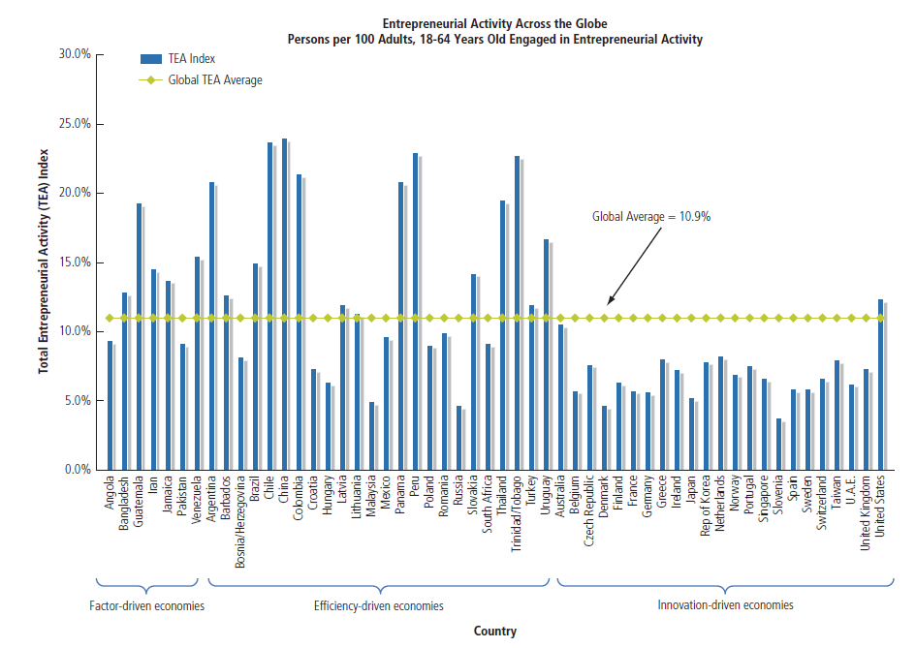
Entrepreneurial Activity Across the Globe

Slide 4
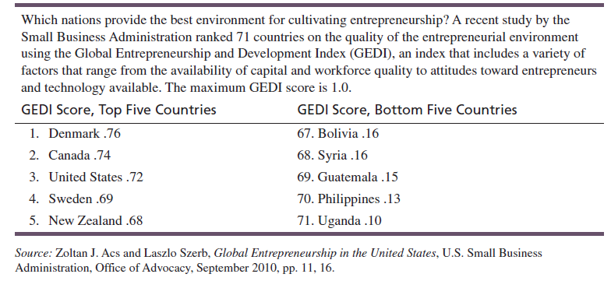
Entrepreneurship-Friendly Nations

Slide 5

The World of the Entrepreneur
Global Entrepreneurship Monitor (GEM) study reports:
Men are twice as likely to start a business as women.
Most entrepreneurs turn to family members and friends for capital.
Entrepreneurs are most likely to launch businesses when they are between the ages of 35 and 44.

Slide 6



What is an Entrepreneur?
One who creates a new business in the face of risk and uncertainty for the purpose of achieving profit and growth by identifying opportunities and assembling the necessary resources to capitalize on them.

Slide 7
Characteristics of Entrepreneurs
Desire for responsibility
Preference for moderate levels of risk – risk eliminators
Confidence in their ability to succeed
Determination
Desire for immediate feedback
High level of energy
Future orientation – opportunity, necessity, and serial entrepreneurs
Skilled at organizing
Value achievement over money

Slide 8
Characteristics of Entrepreneurs
Entrepreneurs tend to exhibit:
A high degree of commitment
Tolerance for ambiguity
Flexibility
A willingness to work hard
Tenacity

Slide 9
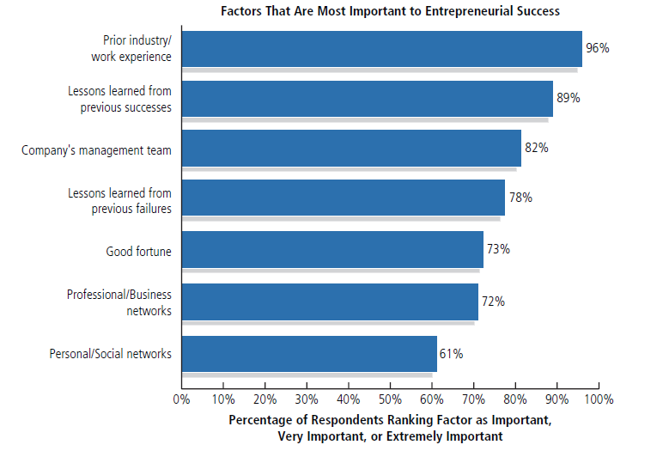
Sources of Entrepreneurial Success

Slide 10
Entrepreneurship
One characteristic of entrepreneurs stands out:
Diversity!
Anyone – regardless of age, race, gender, color, national origin, or any other characteristic – can become an entrepreneur (although not everyone should).

Slide 11

Benefits of Entrepreneurship
The opportunity to:
Create your own destiny
Make a difference
Reach your full potential
Reap impressive profits
Contribute to society and to be recognized for your efforts
Do what you enjoy and to have fun at it

Slide 12

Drawbacks of Entrepreneurship
Uncertainty of income
Risk of losing your entire investment
Long hours and hard work
Lower quality of life until the business gets established
High levels of stress
Complete responsibility
Discouragement

Slide 13
Feeding the Entrepreneurial Fire
Entrepreneurs as heroes
Entrepreneurial education
Demographic and economic factors
Shift to a service economy
Technology advancements
Independent lifestyle
The Internet and cloud computing

Slide 14
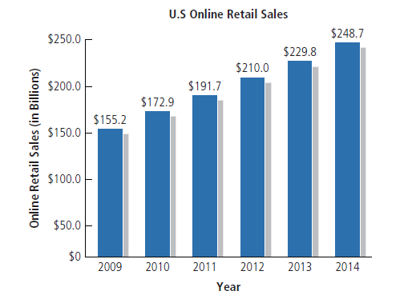
U.S. Retail E-Commerce Revenues

Slide 15
Feeding the Entrepreneurial Fire
(continued)
Entrepreneurs as heroes
Entrepreneurial education
Demographic and economic factors
Shift to a service economy
Technology advancements
Independent lifestyles
The Internet and cloud
computing
International opportunities

Slide 16

The Cultural Diversity of Entrepreneurship
Young entrepreneurs

Slide 17
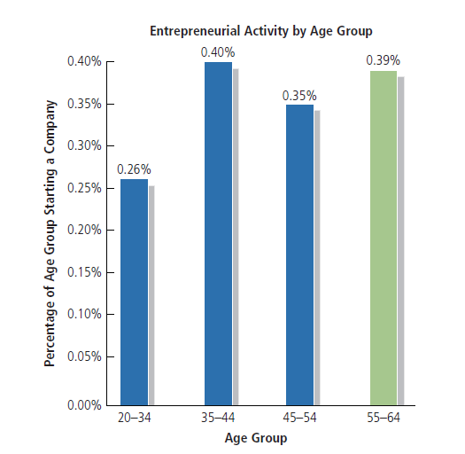
Entrepreneurial Activity by Age Group

Slide 18
The Cultural Diversity of Entrepreneurship
(continued)
Young entrepreneurs
Women entrepreneurs
Minority-owned enterprises

Slide 19
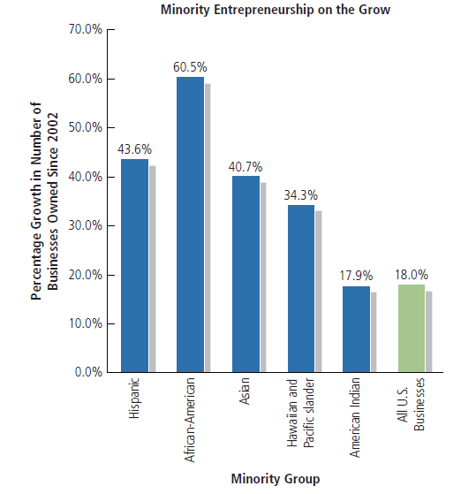
Growth in Minority–Owned Businesses since 2002

Slide 20

The Cultural Diversity of Entrepreneurship
(continued)
Young entrepreneurs
Women entrepreneurs
Minority-owned enterprises
Immigrant entrepreneurs
Part-time entrepreneurs

Slide 21

The Cultural Diversity of Entrepreneurship
(continued)
Home-based businesses
Family businesses
Copreneurs
Corporate castoffs
Corporate dropouts
Social entrepreneurs
Retiring baby boomers

Slide 22

Small Businesses ...
Make up 99.7% of the 27.9 million businesses in the U.S.
Employ 50% of the nation’s private sector workforce.
Create more jobs than big businesses.
65% of net new jobs over the last decade
3% of small companies create
70% of net new jobs in the
economy.
Gazelles

Slide 23
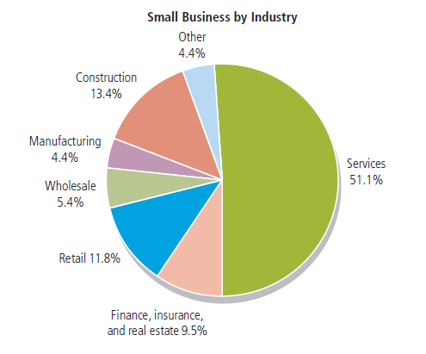
Small Businesses by Industry

Slide 24

Small Businesses ...
(continued)
Produce 51% of the nation’s private GDP.
Account for 47% of business sales.
Create 13 times more patents per employees than large companies.
Zipper, light bulb, FM radio, laser, air conditioning, escalator, personal computer, automatic transmission, and many more!

Slide 25
Putting Failure Into Perspective
Entrepreneurs are not paralyzed by the prospect of failure.
Failure – a natural part of the creative process.
Successful entrepreneurs learn to fail intelligently.

Slide 26
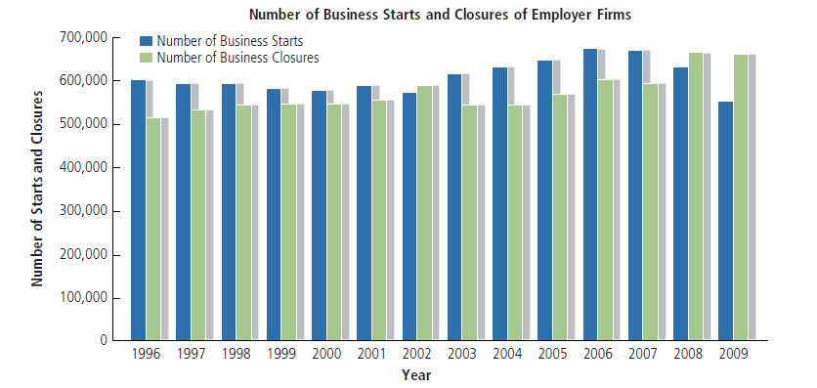
Business Starts and Closures

Slide 27
Avoiding the Pitfalls of Small Business Failure
Know your business in depth
Develop a solid business plan
Manage financial resources
Understand financial statements
Learn to manage people effectively
Set your business apart from the competition
Maintain a positive attitude

Slide 28
Conclusion
Entrepreneurs:
Are an important part of the free enterprise system
Are a diverse and talented group of people
Represent a cross-section of society as a whole
Are able to enhance the profitability of their businesses through acquiring additional knowledge and experience
Ch. 1: The Foundations of Entrepreneurship

Slide 29
What is Ahead?
Section 1: The Challenge of Entrepreneurship
Section 2: Building a Business Plan: Beginning Considerations
Section 3: Building a Business Plan: Marketing Considerations
Section 4: Building a Business Plan: Financial Matters
Section 5: Putting the Business Plan to Work: Making the New Venture a Success
Ch. 1: The Foundations of Entrepreneurship

Slide 30


